Slide 1
HOSPITAL FINDER
PIP2001 Capstone Project
Review-0
Batch Number:
Roll Number | Student Name
20211ISR0056 | AMULYA B
20211ISR0053 | SNEHA N
20211ISR0054 | BHAVANA A
20211ISR0049 | HEMANTH GOVINDA RAJ
Under the Supervision of,
Dr.Akshatha Y
School of Computer Science and Engineering
Presidency University
Name of the Program: B. TECH
Name of the HoD: ZAFAR ALI
Name of the Program Project Coordinator: Dr.Akshatha Y
Name of the School Project Coordinators: Dr. Sampath A K / Dr. Abdul Khadar A / Mr. Md Ziaur Rahman

Slide 2
Content
Problem Statement
Github Link
Analysis of Problem Statement
Timeline of the Project
References

Slide 3
Problem Statement Number:
Organization: CDK Global(India)Pvt Ltd
Category (Hardware / Software / Both) : Software
Problem Description: In the state of mind that a common person is in during a medical emergency, it becomes difficult to take calculated decisions such as which hospital to rush to. This lapse of decision could mean the difference between life or death for a loved one. Additionally, there are several aspects to consider such as availability of the required medical facilities, medicines, blood group and specialists to provide the patient with a maximum chance of survival in those crucial moments. Our app aims to be the solution, giving the user all the necessary information during a medical emergency taking into account their location and requirements and providing the best-suited hospital in that hour of need.
Difficulty Level: Simple

Slide 4
Github Link
The Github link provided should have public access permission.
Github Link
https://github.com/AMULYAB2003/HOSPITAL_FINDER.git

Slide 5
Analysis of Problem Statement
Technology Stack Components:
ANDROID STUDIO: Android Studio is the official integrated development environment (IDE) for Android application development. It is based on IntelliJ IDEA, a Java integrated development environment for software, and incorporates its code editing and developer tools. It support application development within the Android operating system, Android Studio uses a Android Emulator, code templates and GitHub integration

Slide 6
Analysis of Problem Statement (contd...)
Software Requirements:
Latest Stable Version: Ensure you have the latest stable release of Android Studio.
Programming Languages: Python, JavaScript, React Native, MySQL.
Emulator or Physical Device: To test your app, you’ll need either an Android Virtual Device (AVD) or a physical Android device.
GitHub Desktop: A GUI tool for managing your Git repositories .

Slide 7
Analysis of Problem Statement (contd...)
In a medical emergency, making swift and informed decisions is critical, yet the high-stress situation often makes it difficult for individuals to choose the right hospital. The decision of which hospital to rush to can indeed be a matter of life or death. This difficulty is compounded by the need to consider various factors such as the availability of specific medical facilities, necessary medications, compatible blood types, and the presence of specialist doctors.
To address this problem, the proposed solution is a mobile app designed to provide crucial information in these high-pressure moments. The app aims to simplify the process of selecting the best hospital by leveraging real-time location tracking to identify nearby hospitals and offering detailed information about their facilities. It will integrate with hospital databases to provide up-to-date data on bed availability, blood types, and essential medicines. Additionally, users will be able to filter hospitals based on their specific needs, such as emergency care or specialist availability, and receive clear, turn-by-turn navigation to their chosen hospital.
By offering a user-friendly interface and real-time updates, the app seeks to ensure that individuals can make quick, informed decisions about where to seek medical care, ultimately improving the chances of survival and providing peace of mind in critical moments.

Slide 8
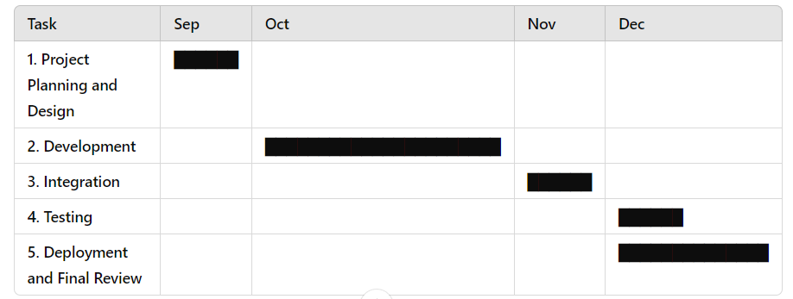
Timeline of the Project (Gantt Chart)

Slide 9
References (IEEE Paper format)
https://www.youtube.com/watch?v=9CkpMm-n5iA
https://github.com/SamiAlavi/Hospital-Management-System.git

Slide 10


